Slide 1
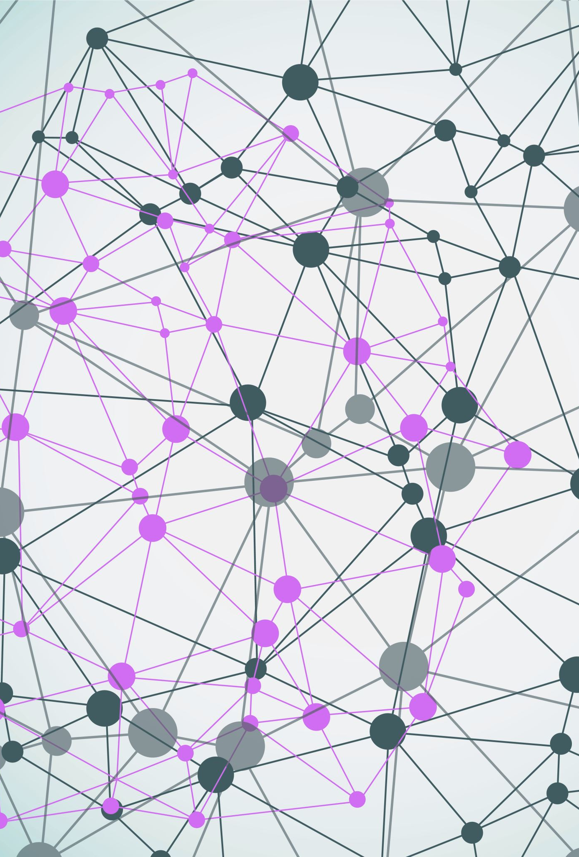
Harnessing Artifacts: Classifying Gait Events with Machine Learning and Dual Layer EEG Data

Slide 2
Project Overview
This study addresses the challenge of accurately predicting gait events from brain activity. Traditionally, Electroencephalography (EEG) signals have been viewed as a reflection of brain dynamics, with motion artifacts considered noise and discarded. We propose an innovative approach leveraging these artifacts as additional information about ongoing processes in the body during locomotion, combining them with conventional EEG data in dual-layer datasets to predict gait events. The datasets include the motion artifact layer alone, scalp channel data only, and cleaned source signals alone. Various machine learning models, such as Random Forest, Logistic Regression, Support Vector Machines, LSTM RNN, are trained on these datasets.

Slide 3
Experimental Setup
The data for this project is collected using a dual-layer EEG setup, with each layer consisting of 128 channels. The inner layer records brain activity, which includes signals from the brain as well as noise/artifacts from various sources such as muscle, eye, heart, and motion. The outer layer is shielded from brain activity and only records motion artifacts.
The experiment involves 14 subjects walking on a treadmill under four conditions: Left Heel Strike (LHS) with Stick/Slip and Left Mid Stance (LMS) with Stick/Slip. Each subject's experiment lasts for 12 minutes, with a 2-minute baseline pre and post the walking. During the first and last 2 minutes, no perturbations are applied. In the middle 8 minutes, perturbations are applied with one random catch trial between every 5 perturbations.
The current study focuses on the unperturbed events, where no perturbation is applied. This allows for a more focused analysis of the EEG data and the prediction of gait events. ***The data in this study is collected at a rate of 512 samples per second. This high sampling rate allows for detailed analysis of the EEG signals and the prediction of gait events.

Slide 4
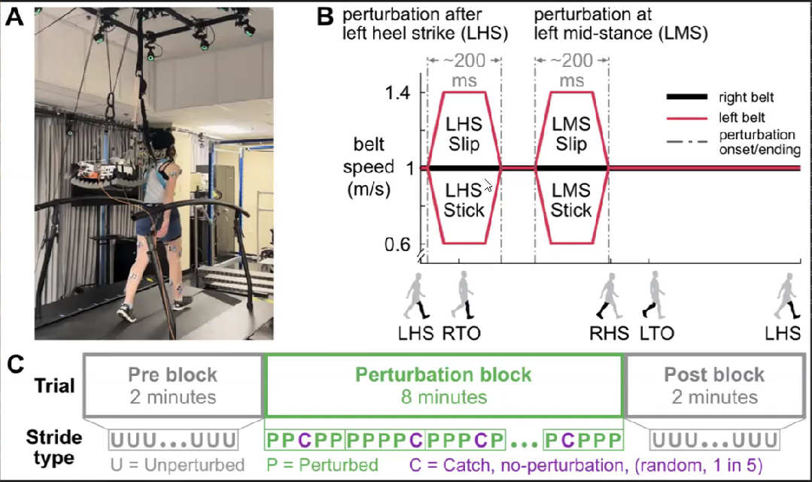

Slide 5
Dataset Format and Details
The dataset for each subject is stored in a .set file. These files contain a 14-minute recording for both the inner and outer layers of the EEG setup. The project involves five datasets, which include:
Motion artifact layer alone (78/128 channels): The 78 channels are randomly selected out of 128 channels for each subject.
Source signals after cleaning (78 sources): Independent Component Analysis (ICA) is applied on the raw EEG data for the inner layer with 78 good channels selected randomly for each subject.
Scalp channel data alone (78/128 channels): The 78 channels are the good channels selected at random after rejection of bad channels.
Note: We have 78 channels because this is the minimum requirement of the number of good channels data recorded for the subject to be considered in the study.
Notes:
The data in this study is collected at a rate of 512 samples per second. This high sampling rate allows for detailed analysis of the EEG signals and the prediction of gait events.

Slide 6
Events
Event Name | Description
CLHS | Description of CLHS event
CLP_On | Description of CLP_On event
CLTO | Description of CLTO event
CRHS | Description of CRHS event
CRTO | Description of CRTO event
PLHS | Description of PLHS event
PLP_On | Description of PLP_On event
PLTO | Description of PLTO event
PRHS | Description of PRHS event
PRTO | Description of PRTO event
ULHS | Description of ULHS event
ULP_On | Description of ULP_On event
ULTO | Description of ULTO event
URHS | Description of URHS event
URTO | Description of URTO event
boundary | Description of boundary event
The events are inserted in the .set file using the recording from the motion capture cameras there are a total of 16 events as mentioned below
we also mark the "no_event" data. This refers to data points where none of the original events are present. We have chosen 53 as the number of these data points, based on the timing of the epoch, which is 0.1 seconds. This means that for every epoch where no original event is detected, we mark it as a "no_event".

Slide 7
Prediction of Gait Events from Dual-Layer EEG Datasets Pipeline
Data Acquisition: -Acquiring EEG data in a format that can be used for analysis reading in EEG data from a .set file, or converting it from other file formats.
Data Preprocessing: -Cleaning and preparing the EEG data for analysis.
->Filtering// (In case futher filtering is required) ->Epoching ->Downsampling ->Reference Correction // ->Normalization ->Dimensionality reduction (PCA ,ICA)
ICA Signals
Feature Extraction: ->Power spectral density ->Time-frequency features ->Event-related potentials ->Temporal features ->Non-linear features
Model Training: ->Decision trees ->Random Forests ->Support Vector Machines ->Neural Networks’
Model Validation: ->Splitting the data into a training and validation set ->Using Cross-Validation methods to estimate model performance.
Model Deployment: ->Using the trained model to make predictions on new EEG data( The predictions can then be used to identify gait events, or for other purposes)
Results Analysis: ->Visualizing the predictions ->Computing performance metrics -> Performing further statistical analyses.

Slide 8
Dataset Preprocessing
Preparing data for the model:
For traditional machine learning models, we need a 2-dimensional data. Hence, after epoching the data, we flatten the data with (epochs, n_channels*n_samples).
We have chosen these "no_event" epochs randomly, equivalent to the number of events. This is a method of undersampling to balance the dataset and prevent the model from being biased towards the majority class.
Normalization: so that the model is not biased towards the large values of a single channel.
To run the deep learning model, we don’t need to flatten the data as it can take 3-dimensional data.

Slide 9
Principal Component Analysis (PCA) Implementation:
We performed PCA on the epoch data that was concatenated across all subjects. This allowed us to reduce the dimensionality of our dataset while preserving the essential information. We then trained our models on this transformed PCA data. The results were encouraging as we achieved similar accuracies to those obtained with the original, higher-dimensional data. This demonstrates the effectiveness of PCA in maintaining the predictive power of our models while significantly reducing the computational complexity.

Slide 10
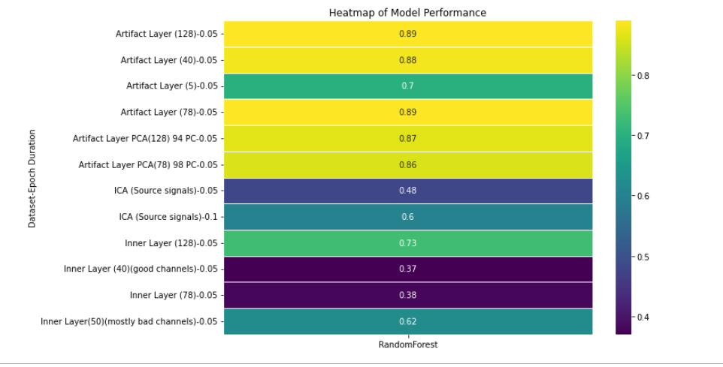
Final Results

Slide 11
Future Work
-We’ll explore the use of regression models to identify gait patterns. The aim is to leverage regression models' ability to handle continuous data, which could provide more granularity in identifying and understanding subtle patterns in the gait event data.
-Experiment with Perturbed events

Slide 12
Conclusion
In conclusion, the results demonstrate that the performance of the machine learning models was poorest for the scalp layer with only good channels. This can be attributed to the fact that the bad channels contained the necessary information about motion artifacts, which enabled the models to accurately predict gait events. In contrast, the scalp layer with only good channels lacked this information, leading to suboptimal model performance.
Furthermore, it is worth noting that the ICA source signals (top 78) performed better than the scalp layer but were still significantly outperformed by the artifact layer. This finding supports the hypothesis that the presence of motion artifact information is crucial for accurate gait event prediction. Therefore, future research should consider incorporating such information when developing machine learning models for gait analysis, as this approach may lead to more reliable and accurate predictions.

Slide 13
Thank you

